Slide 1
MotionAvatar:
An Ungrounded Haptic Device to Show the Self-motion of the Vehicle in Virtual Space
haptic feedback, self-motion, sense of agency, interaction
MASTER THESIS DEFENSE - EMBODIED MEDIA
ZHOU LU - 82136825
ADVISORY COMMITTEE:
Kouta Minamizawa (Supervisor)
Akira KATO (Sub Supervisor)
REVIEW COMMITTEE:
Kouta Minamizawa (Chair)
Akira KATO (Co-Reviewer)
Matthew Waldman (Co-Reviewer)

Slide 2

Structure
Structure
Introduction
Related Works
Concept Design and Implementation
Proof of Concept
Discussion

Slide 3
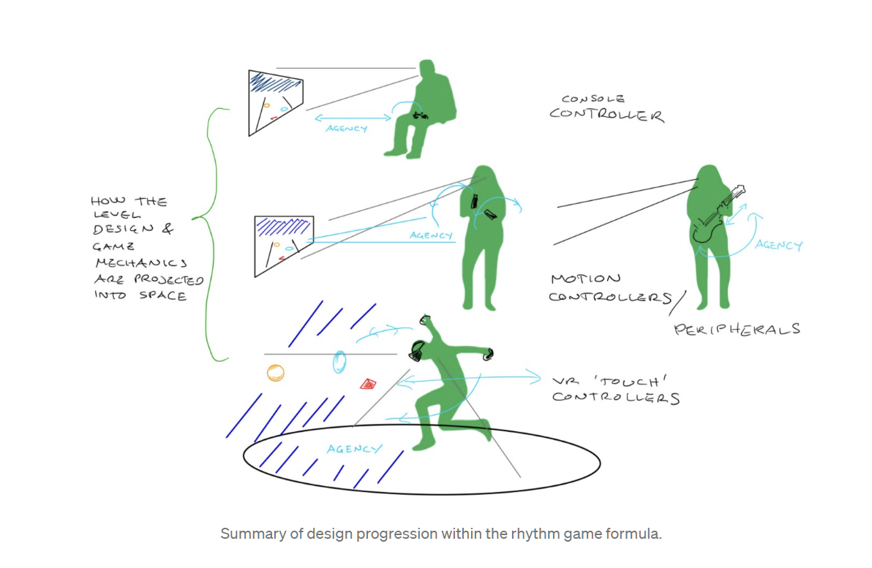
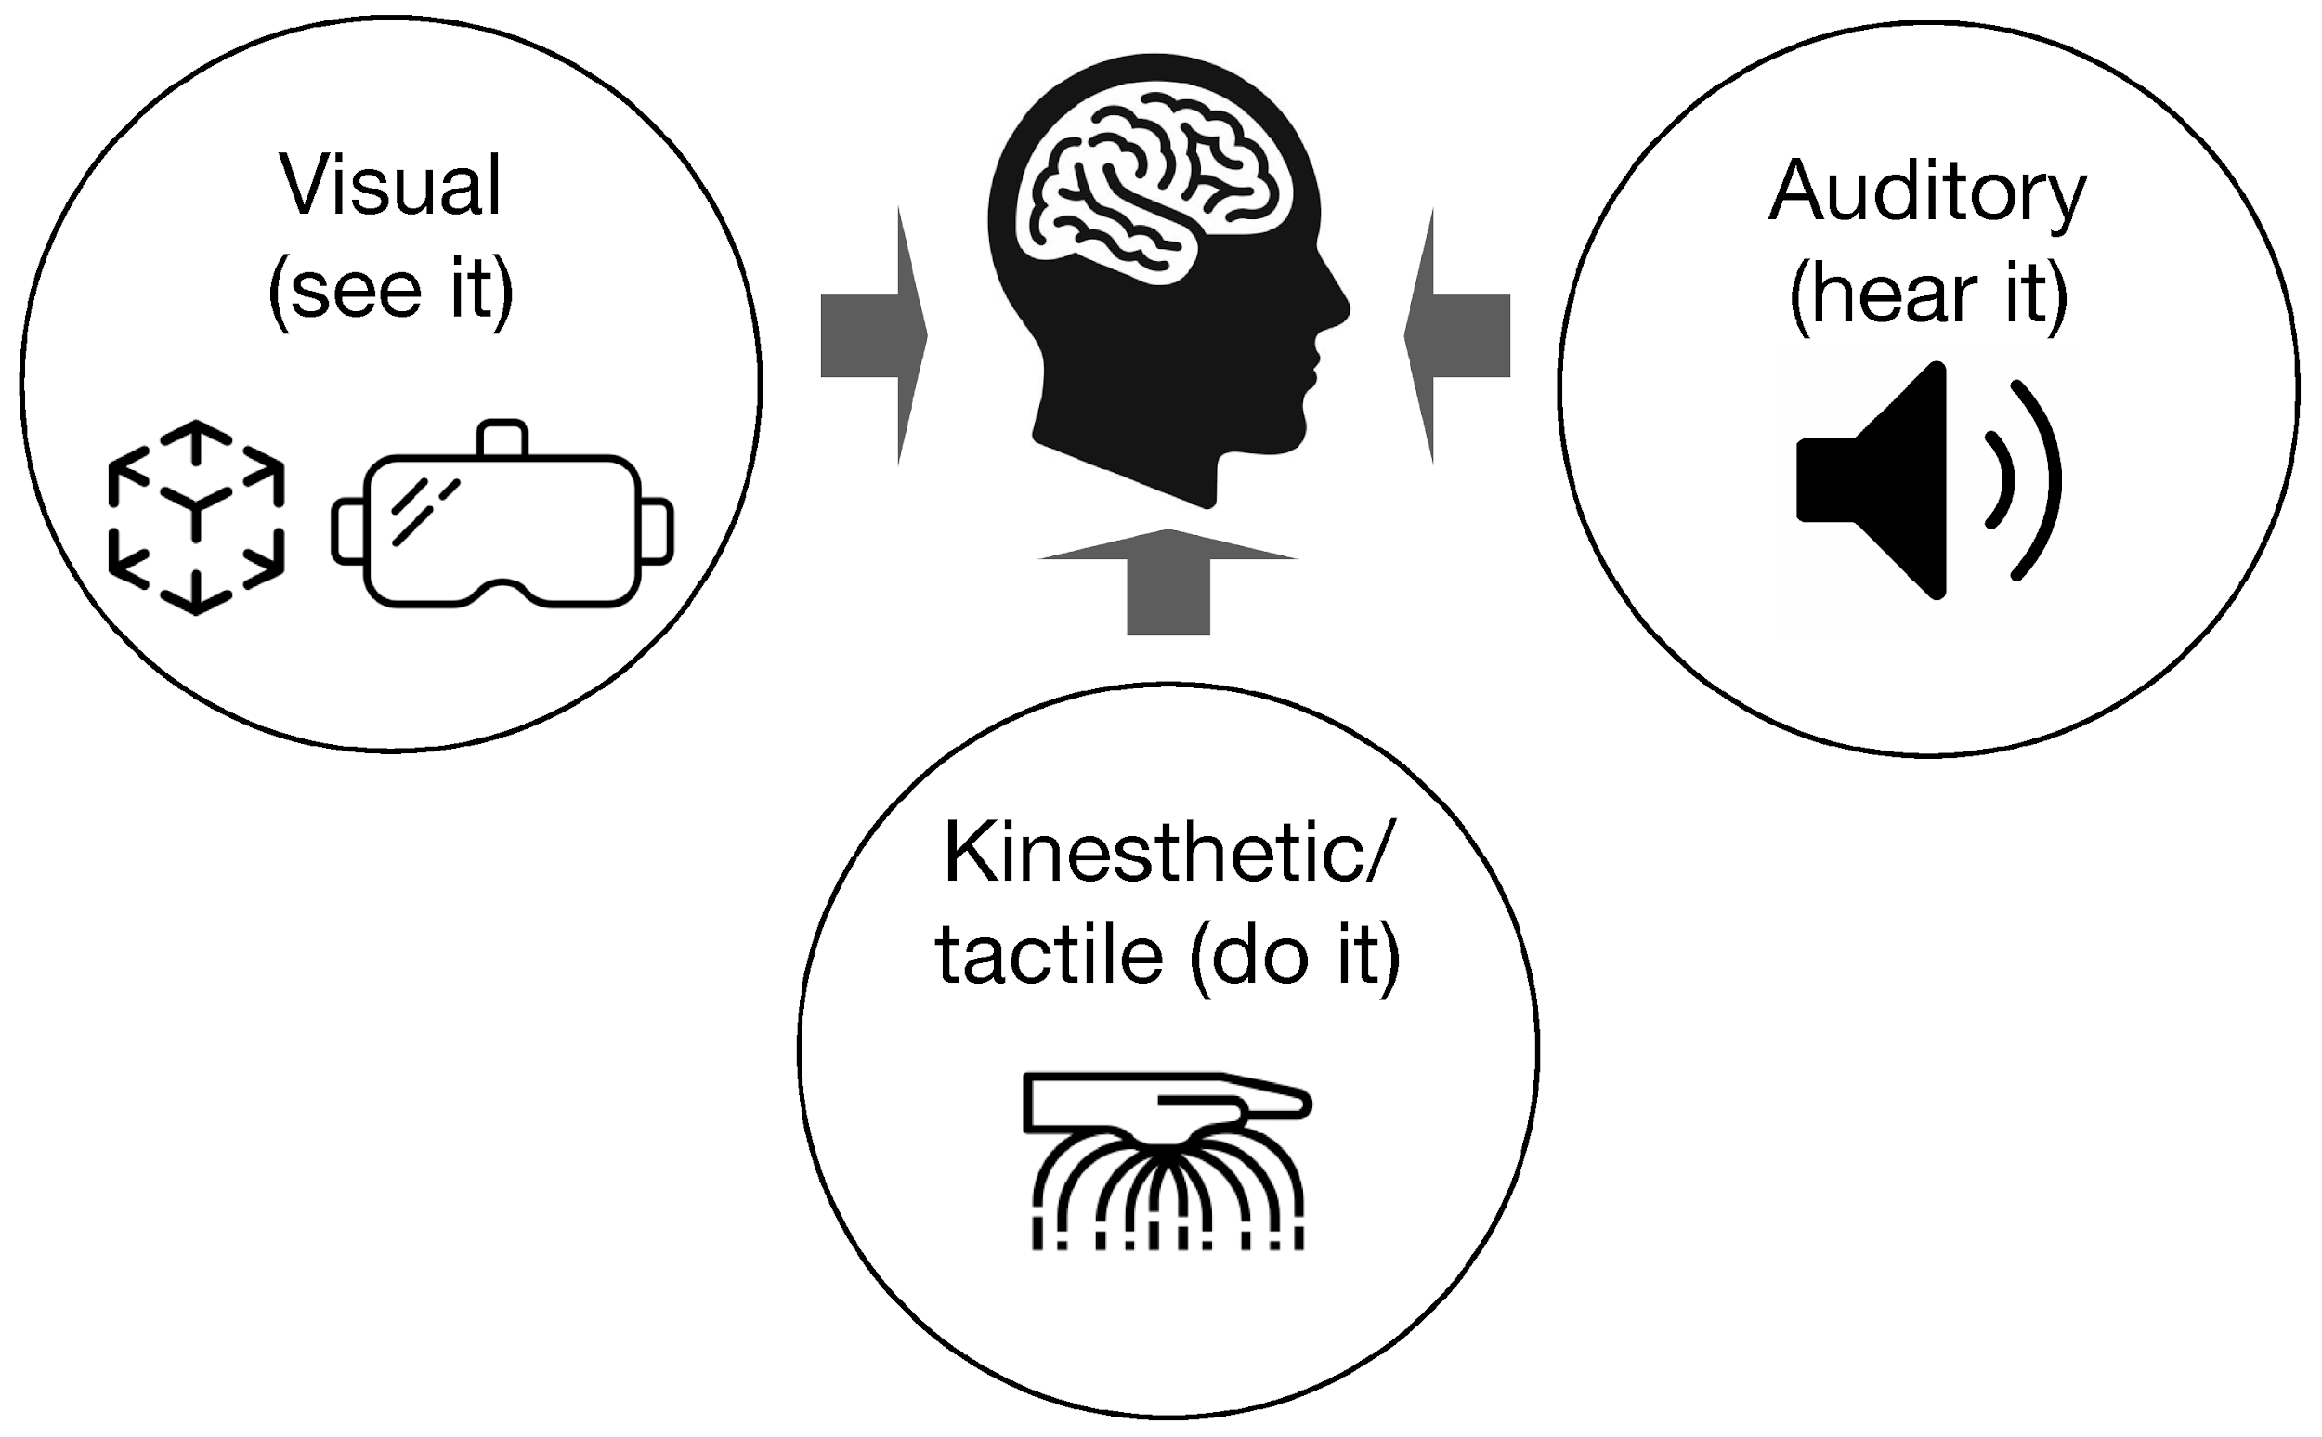
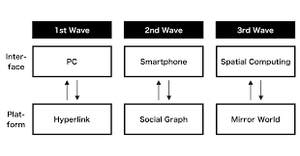
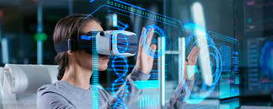
BACKGROUND
Introduction
Spatial computing
Necessity of haptic tech
Notes:
Our interaction is also no longer stuck in the plane, with the mouse or keyboard,
we need a more comprehensive interaction design, such as kinect,
in vr we need to put our body all in vr, every simple movement we made will be meaningful
So this brings up a few questions
How to make the user aware of what kind of movement he is doing, motion state he is
How to make the user realize it what effect his actions and movement are having on the avatar or character he is controlling
And the current interaction in vr is too boring,
we can now watch and listen,
then the next step may be to be able to touch which also proves why our movement and motion are important in future interactions
但是 目前的vr交互上，用户的动作无法被用户感知，例如系统提示我从a移到b来触发砍击动作，
但是从目前的使用感觉上来说用户只会感受到移动，
目前的交互设备不具备渲染较为负责的力学效果

Slide 4
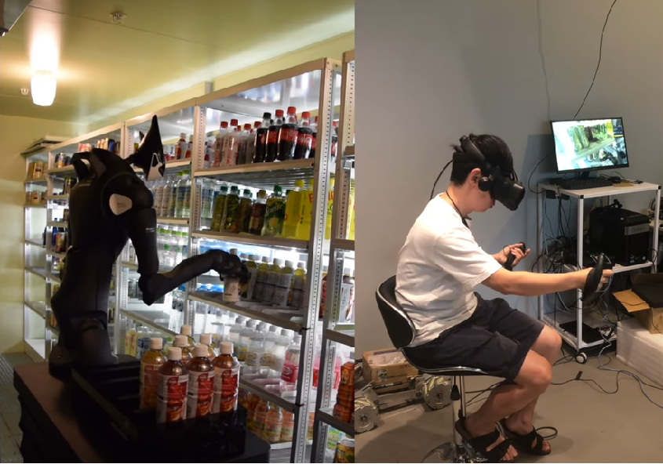
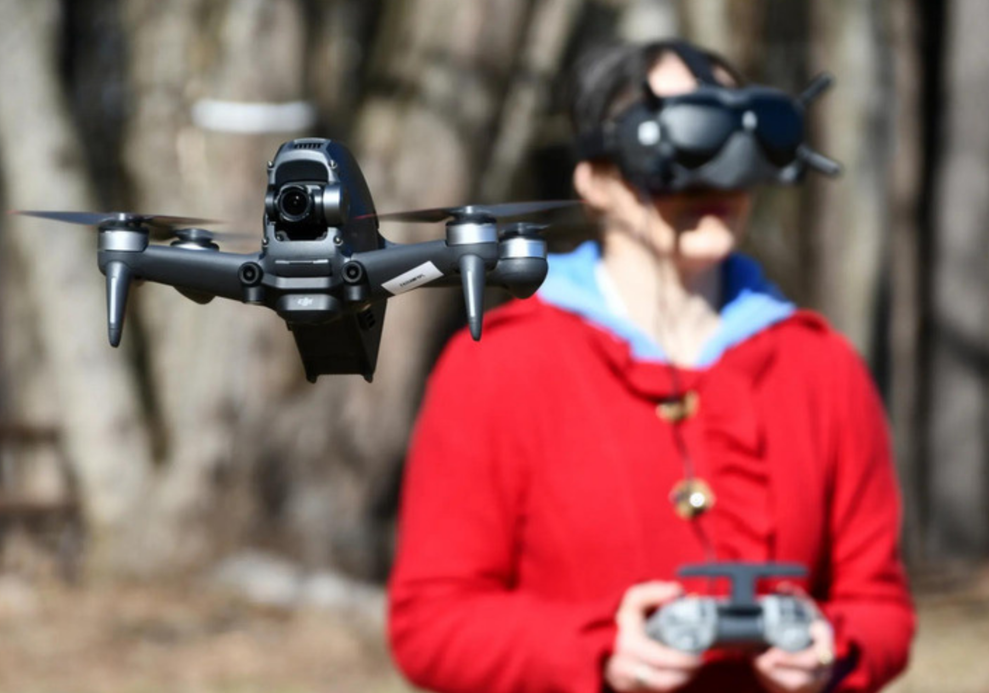
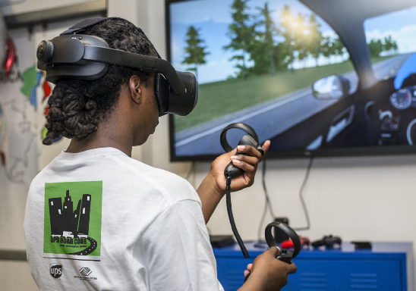
BACKGROUND
Introduction
robot
drone
vehicle

Slide 5

QUESTION
Introduction
Can the motion state haptic feedback make users feel the vehicle’s motion ?
Whether it can improve the sense of connection between the user and the vehicle ?
Whether it can improve the user experience ?
What will we change ?
Notes:
Based on the above, we came up with these questions, which is also this research dedicated to solve

Slide 6
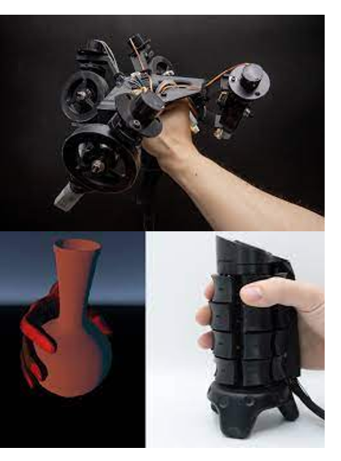
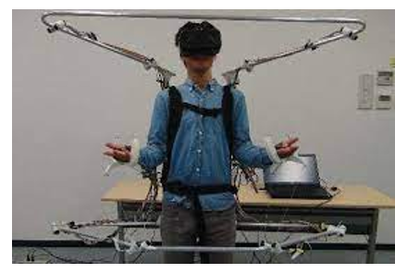
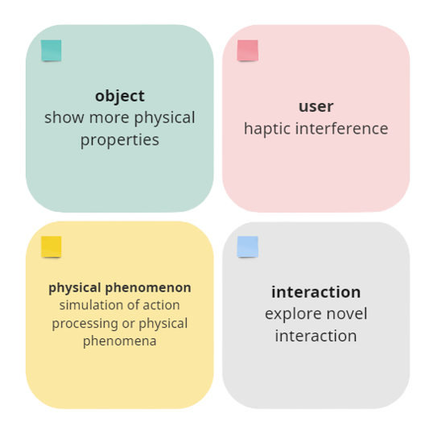
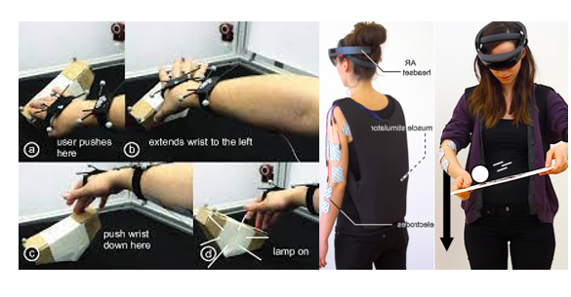
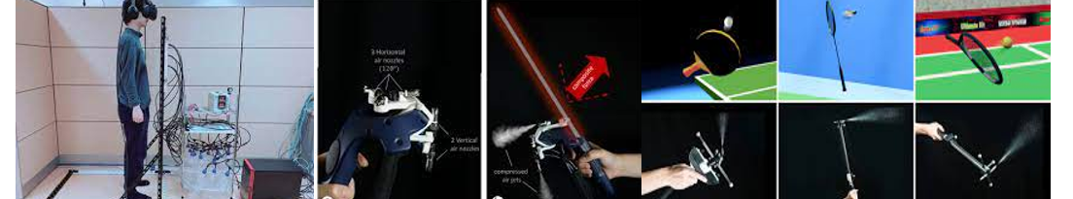
HAPTIC
Related Works
1)Takeru Hashimoto. Metamorphx:An ungrounded 3-dof moment display that changes its physical properties through rotational impedance control.
2)Eric J Gonzalez. X-rings: A hand-mounted 360° shape display for grasping in virtual reality.
3)Kazuki Nagai. Wearable 6-dof wrist haptic device ”spidar-w”.
4)Takahiro Arai and Akifumi Inoue. Blastnel: Collision sensation display
for virtual reality games using highly compressed air.
5)Yu-Wei Wang. Jetcontroller:High-speed ungrounded 3-dof force feedback controllers using air propulsion jets.
6)Ching-Yi Tsai. Airracket: Perceptual design of ungrounded, directional force feedback to improve virtual racket sports experiences.
x)Pedro Lopes. Affordance++: Allowing objects to communicate dynamic use.
x)Pedro Lopes. Adding force feedback to mixed reality experiences and games using electrical muscle stimulation.
Notes:
To think about whether I should focus on a certain movement or a certain motion state

Slide 7
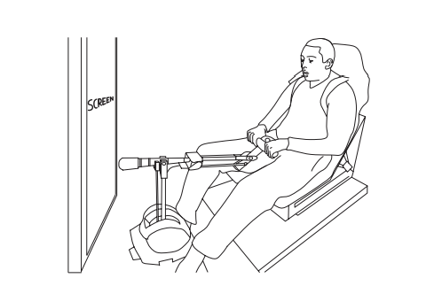
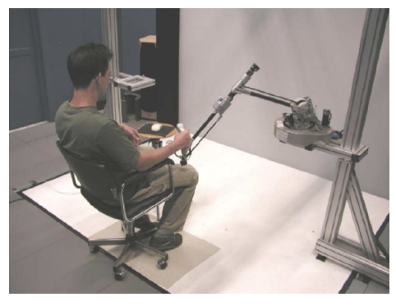
MOTION
Related Works
Michael Rietzler. Vrspinning: Exploring the design space of a 1d rotation platform to increase the perception of self-motion in vr.
Guillaume Bouyer. Inducing self-motion sensations in driving simulators using force-feedback and haptic motion.
Fabien Danieau. Hapseat: Producing motion sensation with multiple force-feedback devices embedded in a seat.
Nizar Ouarti, Anatole L ́ecuyer, and Alain Berthoz. Haptic motion: Improving sensation of self-motion in virtual worlds with force feedback. In 2014 IEEE Haptics Symposium (HAPTICS), pages 167–174, 2014.
A. Lecuyer, M. Vidal, O. Joly, C. Megard, and A. Berthoz. Can haptic feedback improve the perception of self-motion in virtual reality? In 12th International Symposium on Haptic Interfaces for Virtual Environment and Teleoperator Systems, 2004. HAPTICS ’04. Proceedings., pages 208–215, 2004
Notes:
It is possible to communicate the state of motion of a self-moving object to the user through some kind of haptic design
but my idea is that I need a smaller, and more convenient way of designing

Slide 8
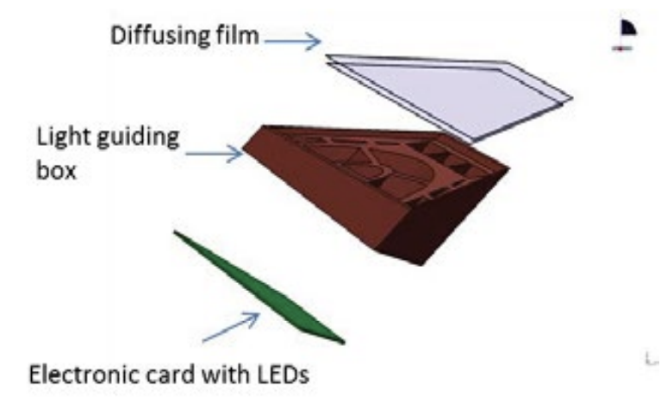
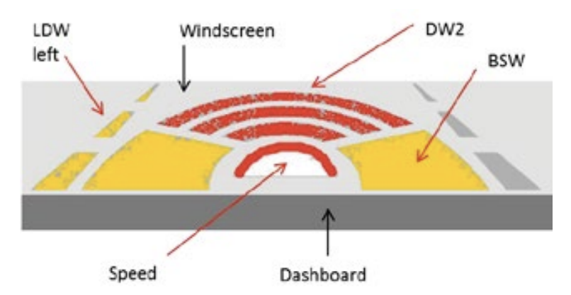
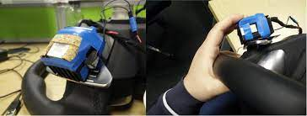
AI DRIVING
Sabine Langlois. Adas hmi using peripheral vision. In Proceedings of the 5th International Conference on Automotive User Interfaces and Interactive Vehicular Applications, AutomotiveUI ’13, page 74–81, New York, NY, USA,2013. Association for Computing Machinery.
Related Works
Patrizia Di Campli San Vito Haptic feedback for the transfer of control in autonomous vehicles. In 12th International Conference on Automotive User Interfaces and Interactive Vehicular Applications, AutomotiveUI ’20, page 34–37, New York, NY, USA, 2020.Association for Computing Machinery.

Slide 9
Concept Design
CONCEPT
Using scrolling to convey the motion information of the vehicle to the user.
Comparison of haptic effect and visual effect on the methodology.
What is the impact on the interaction experience in passive and active scenarios?
Notes:
The final design is to indicate the state of motion to the user by the rotation of the roller.
And compare the difference between the haptic and the visual effect
And explore the impact of the haptic on the user experience in different use cases

Slide 10
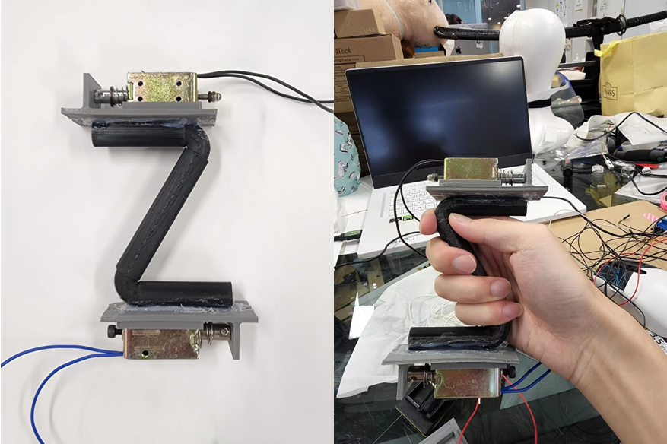
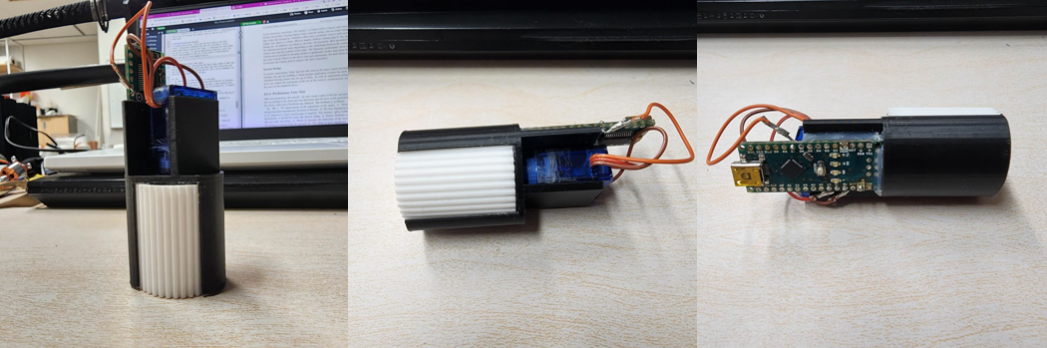
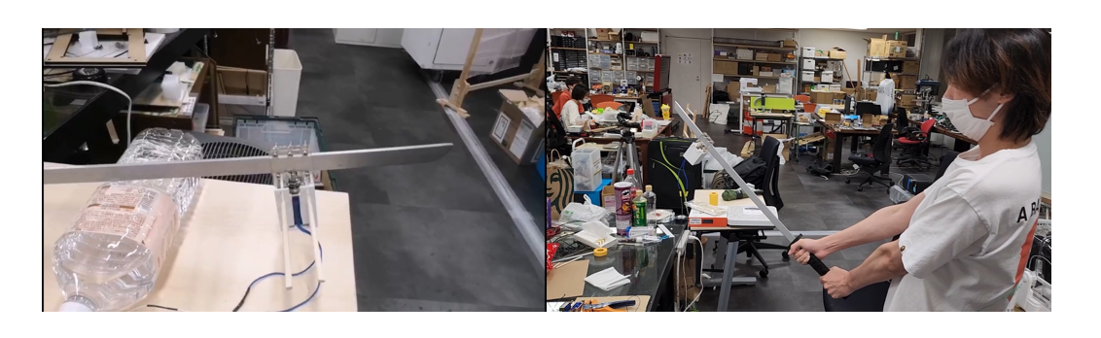
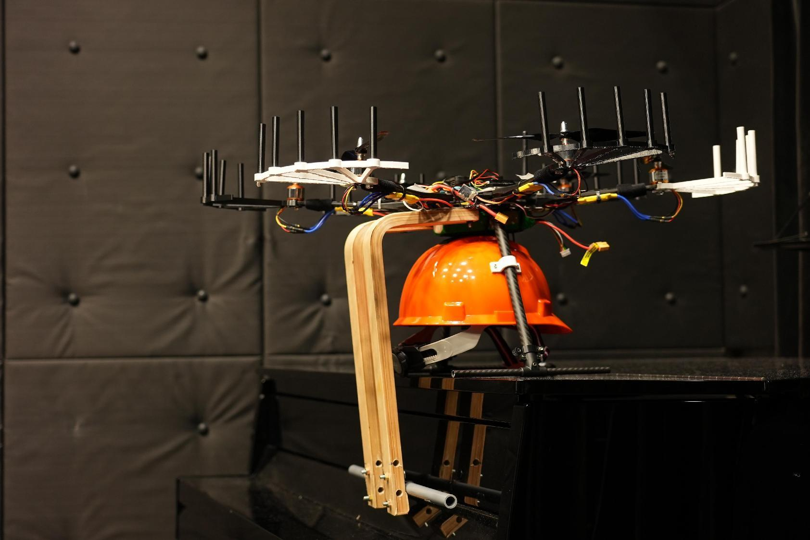
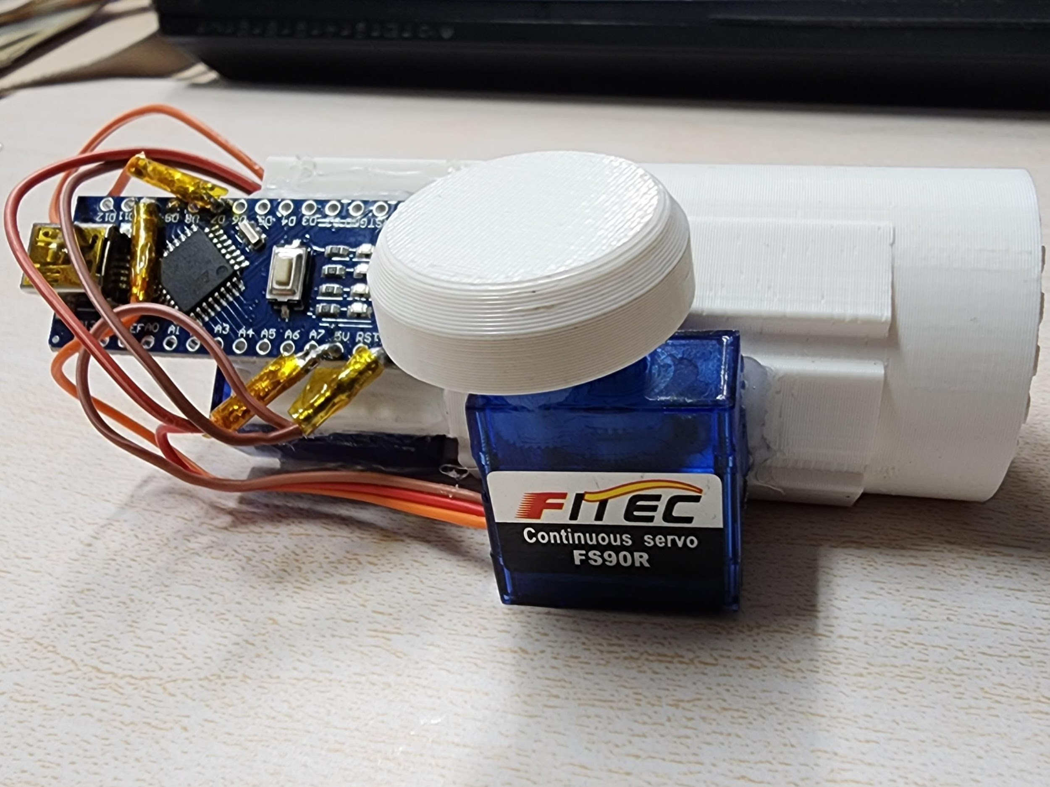
Concept Design
PROTOTYPES
zShape
1dof
MDR1
MDR2
SIDE
MDR3
MDR3
Katana
HumanCopter
MotionAvatar
Notes:
The mdr1 mdr2 project focused on the haptic of the parrying movement,
and the side drone project helped me to understand how users interact with the system regarding degrees of freedom.
1dof was my first trying at using the scrolling to provide force feedback, followed by a simple user test,
and based on the user test, the motionavatar was updated to provide a complete picture of the virtual carrier's motion state

Slide 11
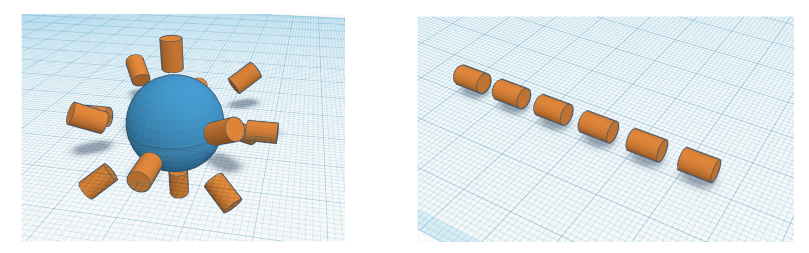
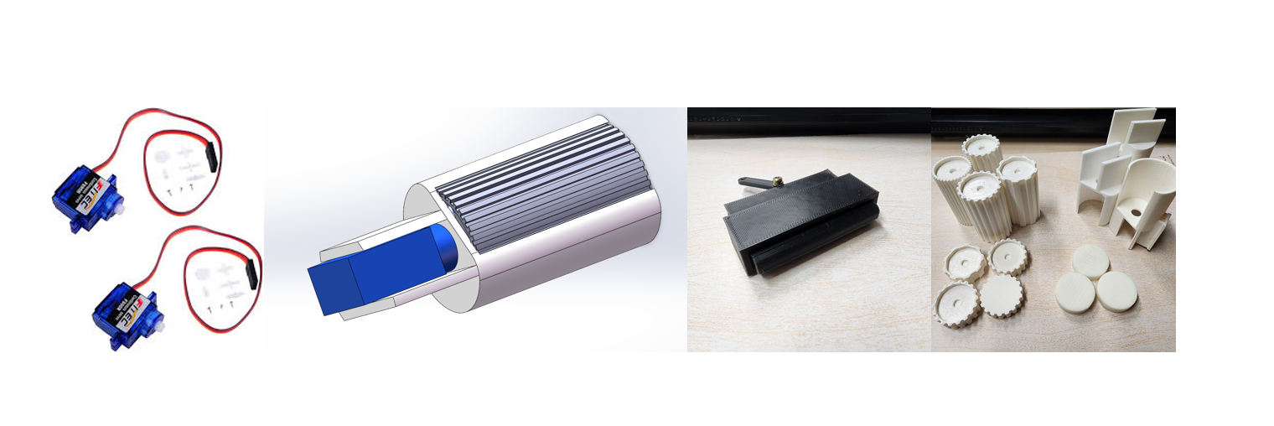
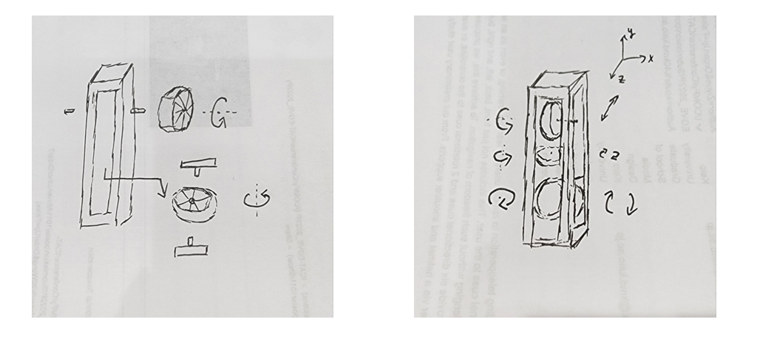
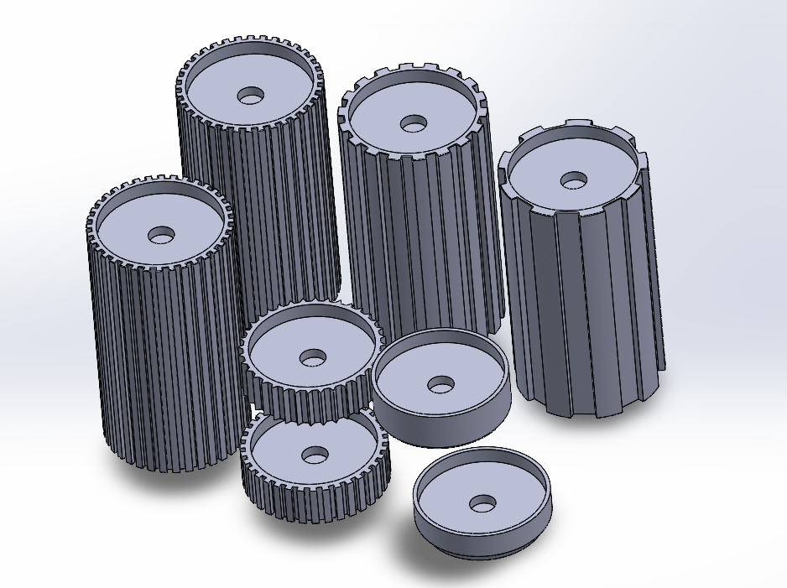
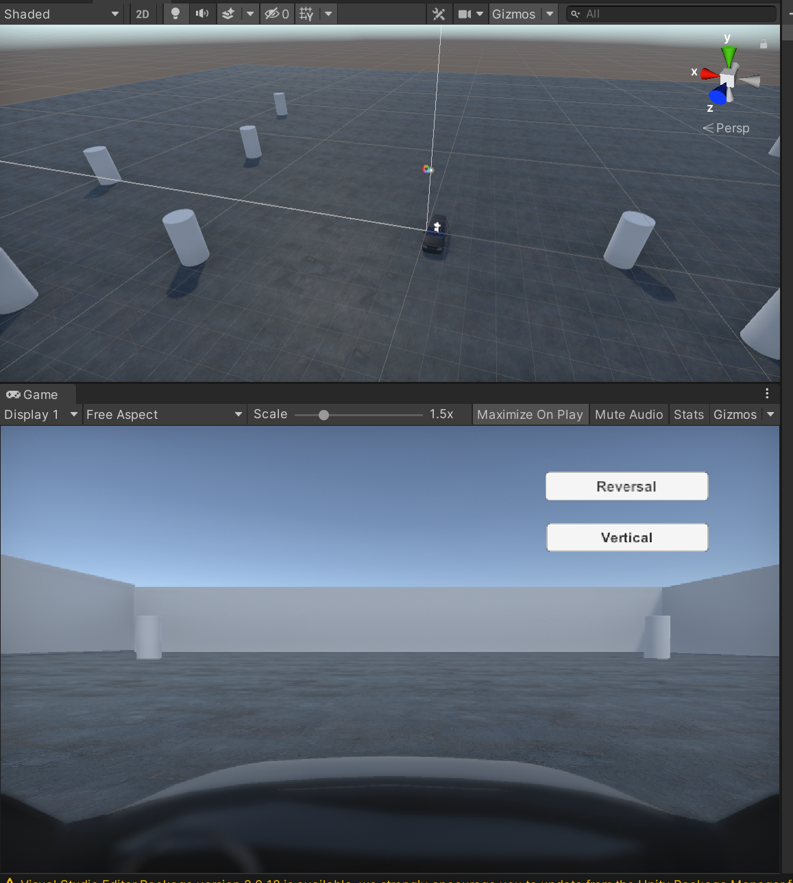
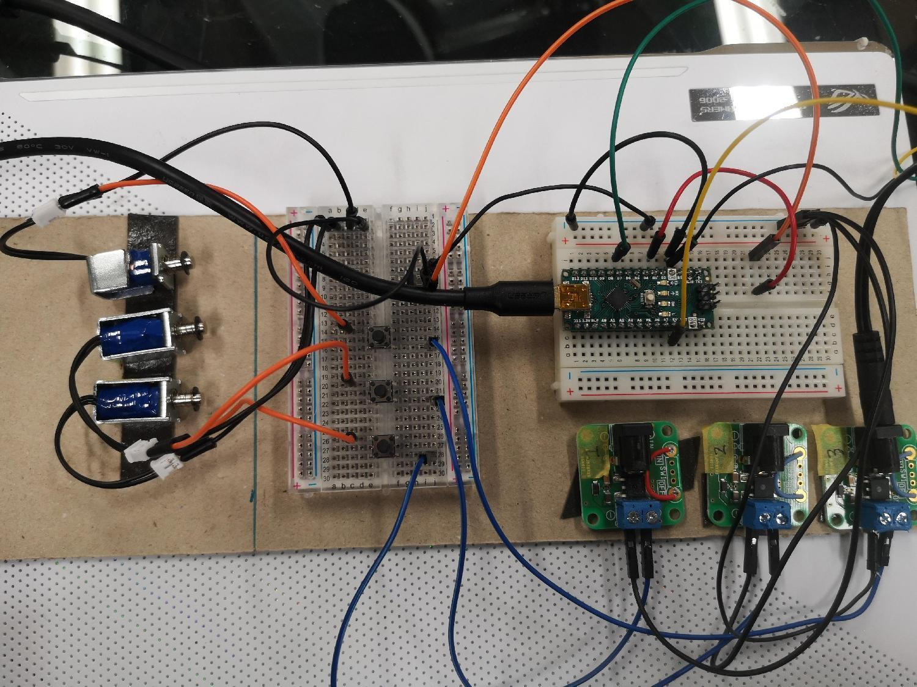
Concept Design
PROCESSING
3d: Solidworks, 3d printer
hardware: Arduino
software: Unity3D
Notes:
This is the process of production, from the draft to 3d design to hardware welding, to the software programming

Slide 12
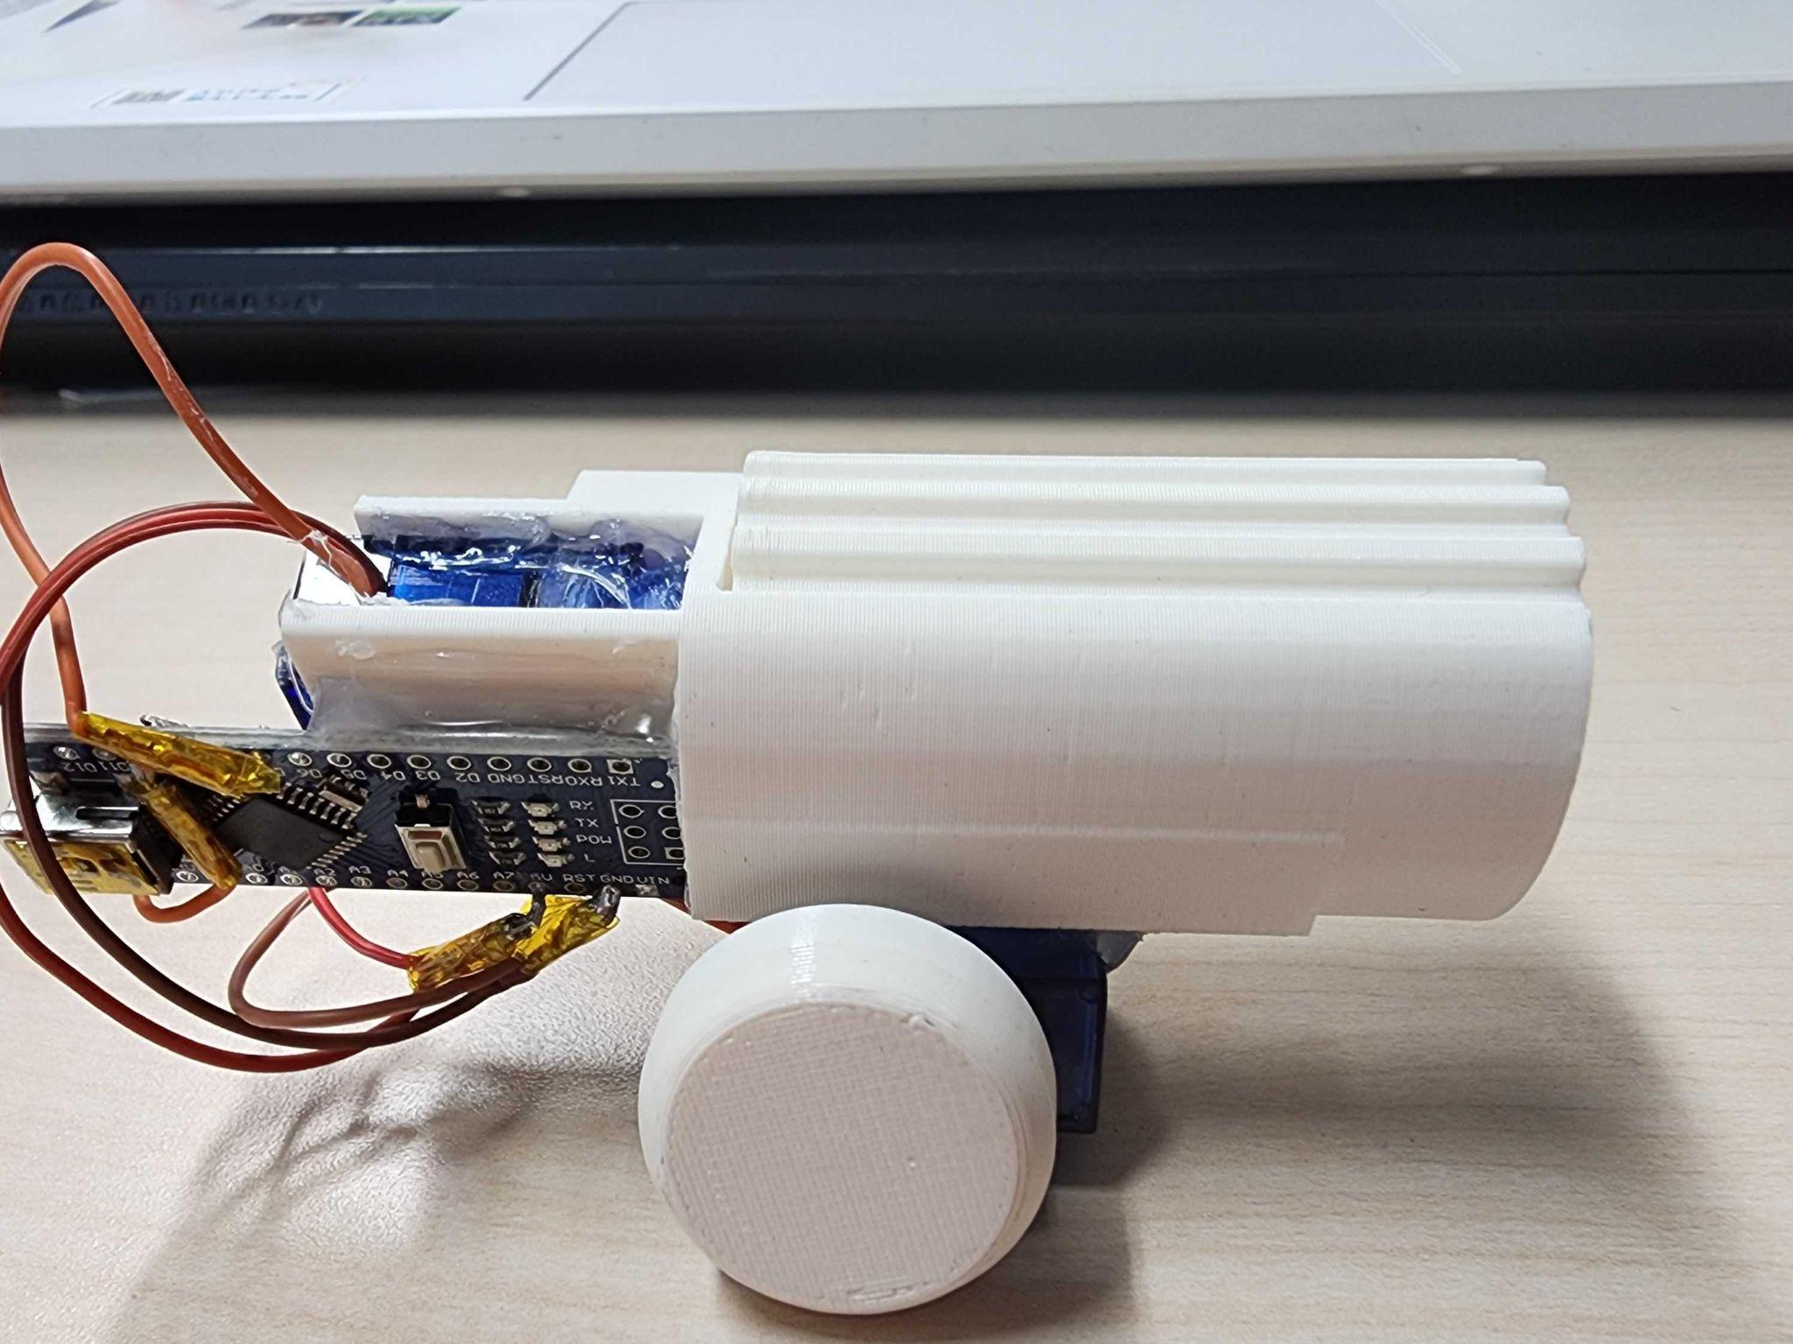
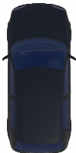
Concept Design
PROTOTYPE
Servo1
Servo2
Notes:
This is how it use, when the virtual car moves back and forth, servo1 will turn clockwise or counterclockwise
When the virtual car turns left and right, servo2 will also turn accordingly, and the user needs to hold it with his left hand to feel the force feedback from the rotation.

Slide 13
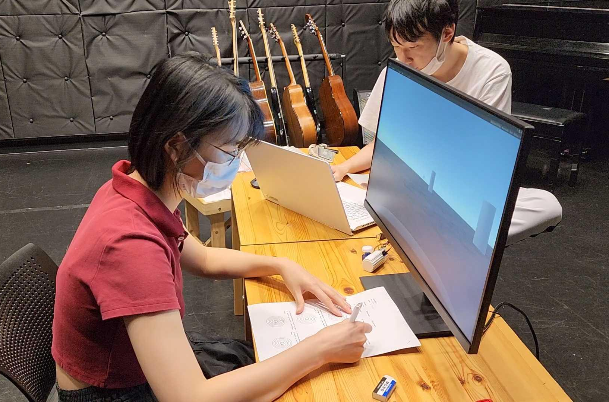
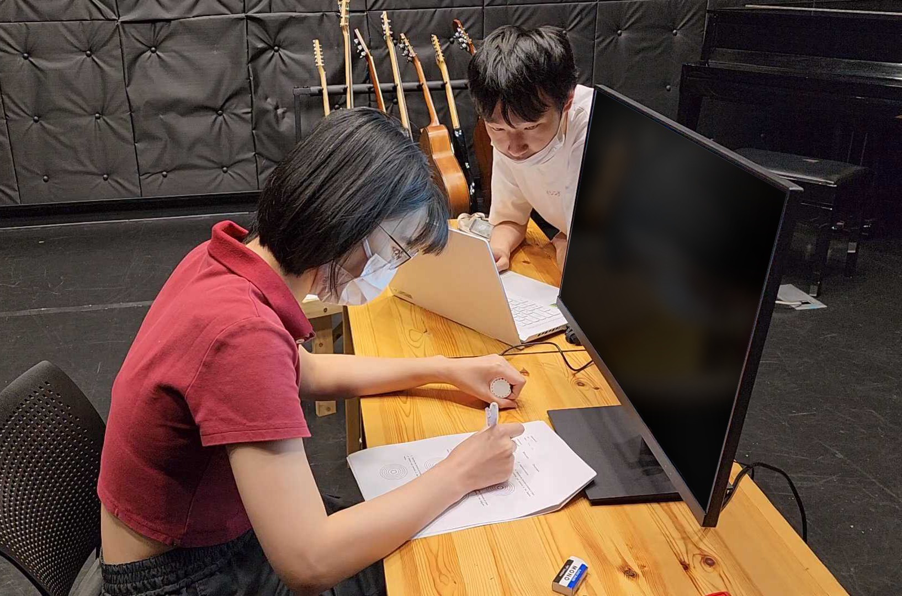
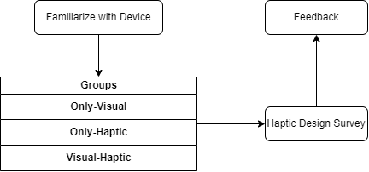
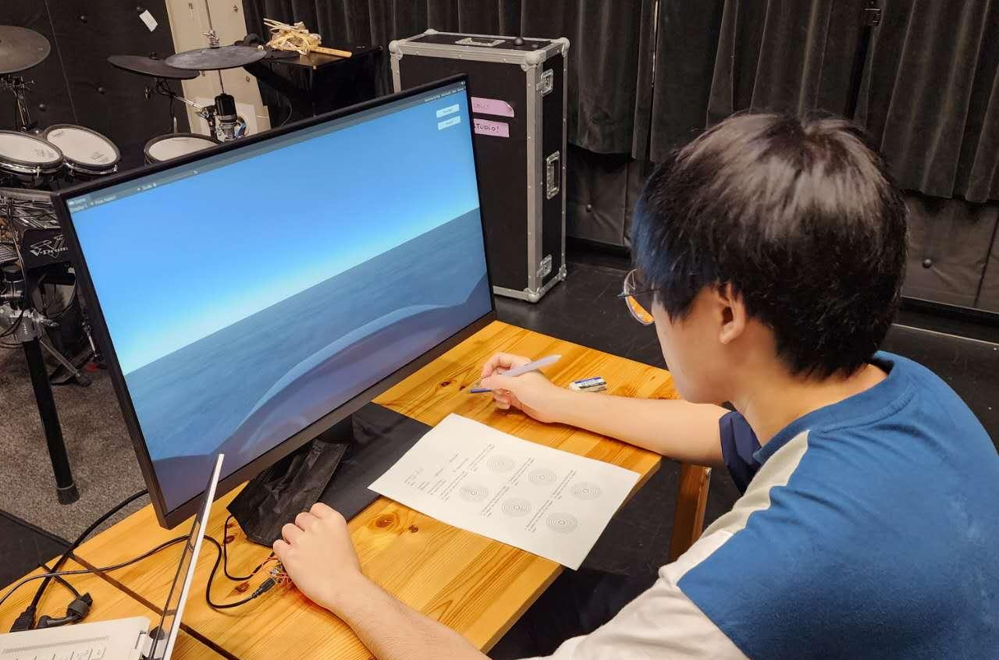
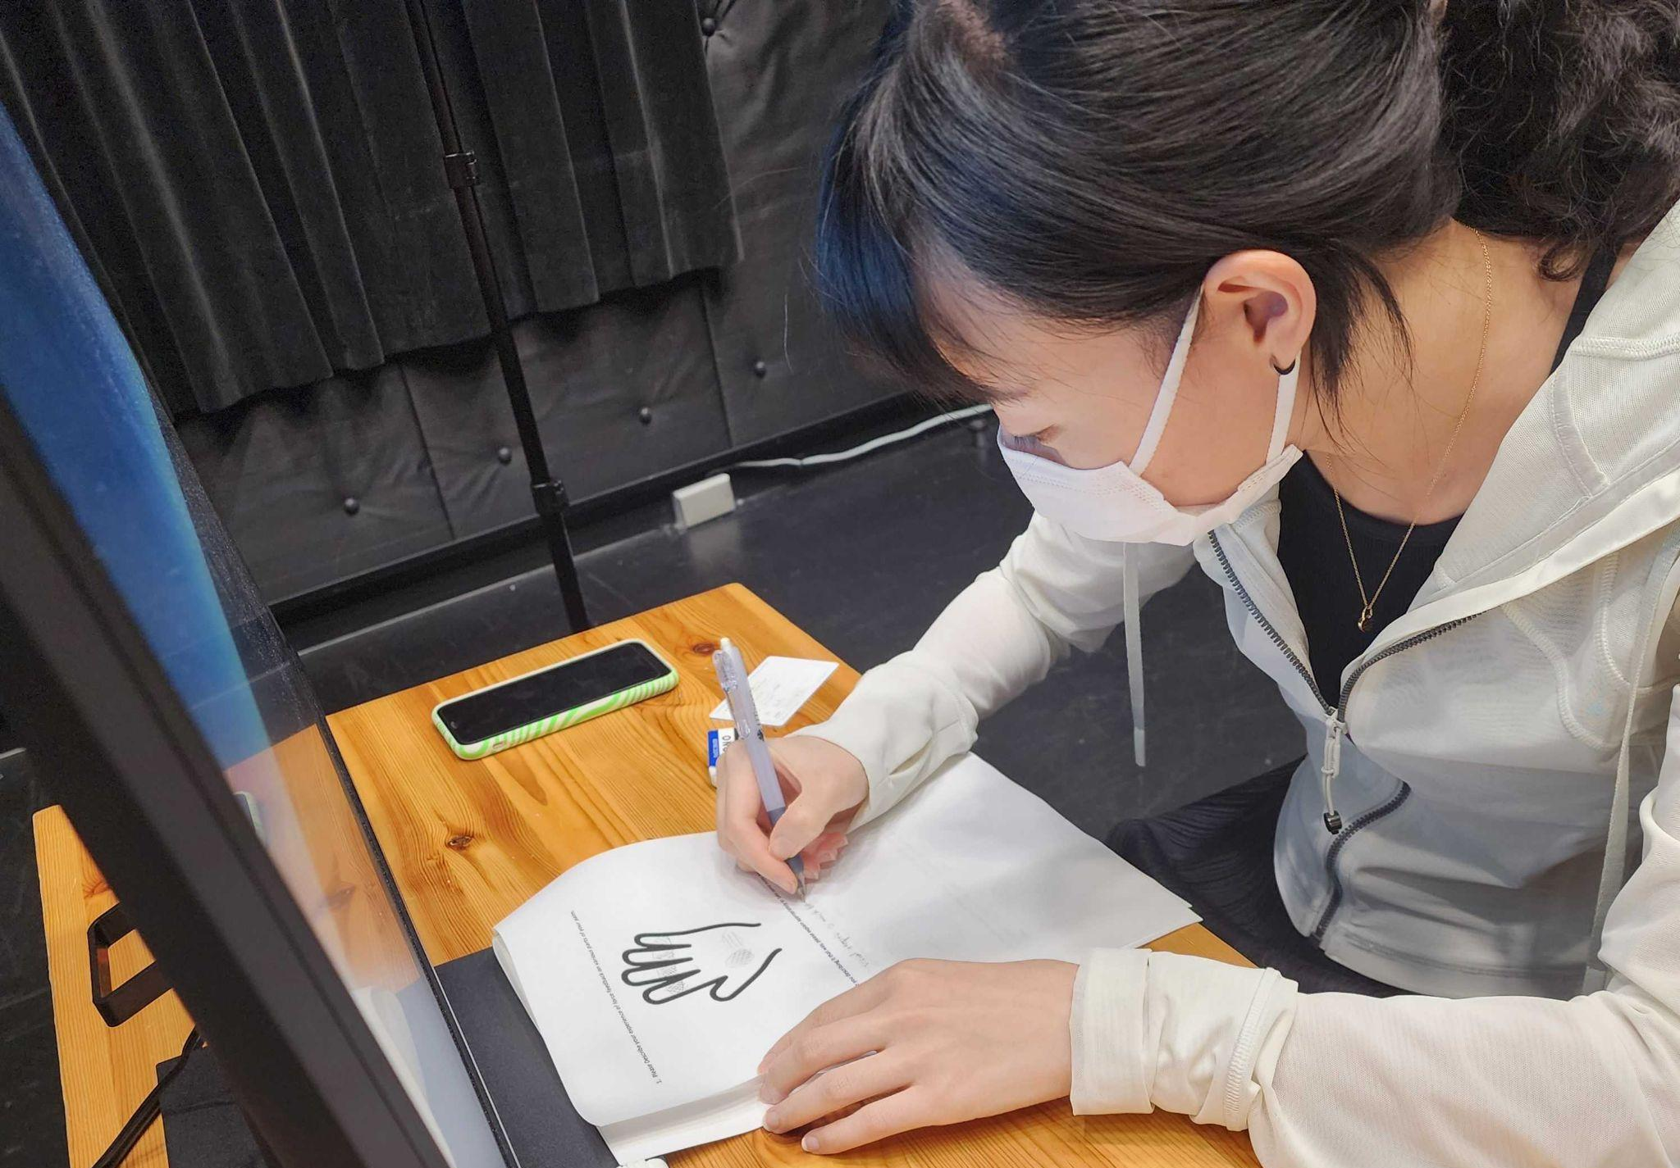
Proof of Concept
EXPERIMENTS
Experiment 1
Haptic Performance (N=10)
Notes:
Two experiments were designed to test the haptic performance of and the user experience

Slide 14
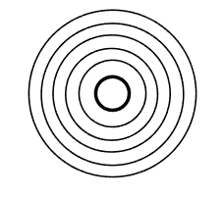



Proof of Concept
Orientation
Hand
EXPERIMENT
1
(forward, backward, left turn, right turn) x (fast, slow)
only 1 time
8 times in total
①
Only-Visual
②
Only-Haptic
③
Visual-Haptic
Describe the haptic feedback of force feedback.
After sensing the ①②③ motion information, the user depict it in the diagram.

Slide 15
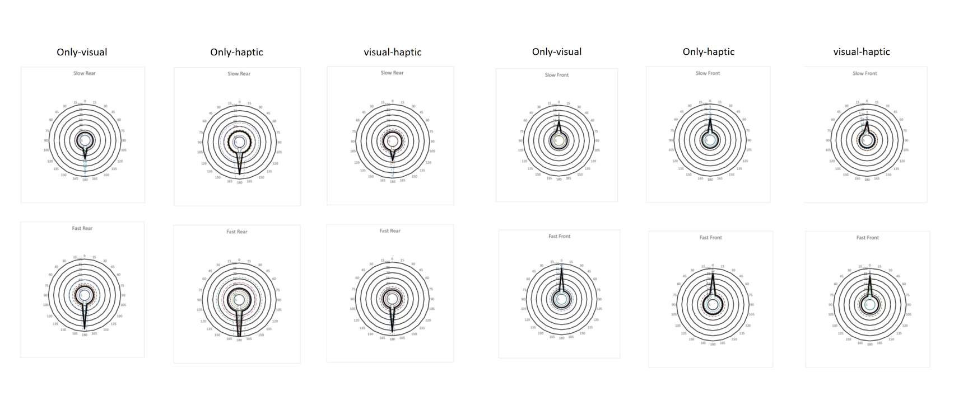



Discussion
RESULTS
Diagram Analysis 1_ forward
directional cues
significant change
deviation to the left

Slide 16

Discussion
RESULTS
Diagram Analysis 1_ backward
directional cues
sensitivity of direction
(haptic)
tendency towards visual

Slide 17
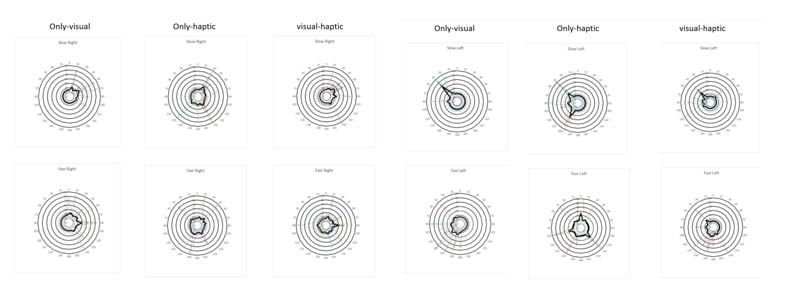
Discussion
RESULTS
Diagram Analysis 1_ turn left
directional cues
sensitivity of rotation
(haptic)
tend to be conservative

Slide 18
Discussion
RESULTS
Diagram Analysis 1_ turn right
directional cues
over-sensitivity
(haptic)
a greater error

Slide 19
Discussion
FINDING
Diagram Analysis 1_ summary
The scrolling design conveys direction accurately but needs improvement in accuracy.
Haptic perception aids motion sensitivity, yet visuals dominate.
Users are more conservative with multi-sensory information.

Slide 20
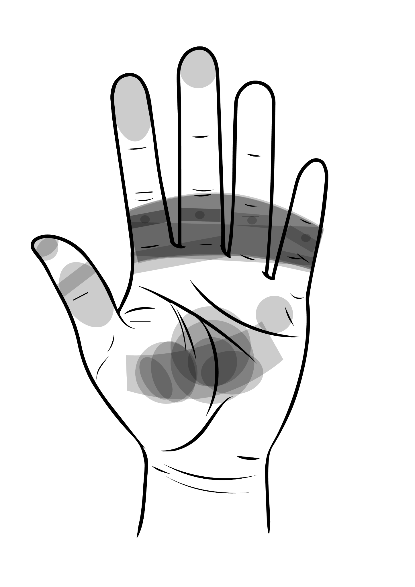
Discussion
RESULTS
Diagram Analysis 2
The design of the roller part should be tilted toward the center of the palm instead of a horizontal position.
The servo2 should be located below the center of the palm, rather than the center of the hand.

Slide 21
Discussion
FINDING
Feedback Analysis:
Haptic can provide better judgement when visual information is insufficient, such as during rotation (010).
Haptic can provide instant feedback about changes (009), a feature where it distinctly outperforms vision.
MotionAvatar can provide a better user experience(002, 004, 008) and a more realistic feeling (001, 005)
MotionAvatar can help users to establish a haptic reference for the self-moving objects in virtual space (005).

Slide 22
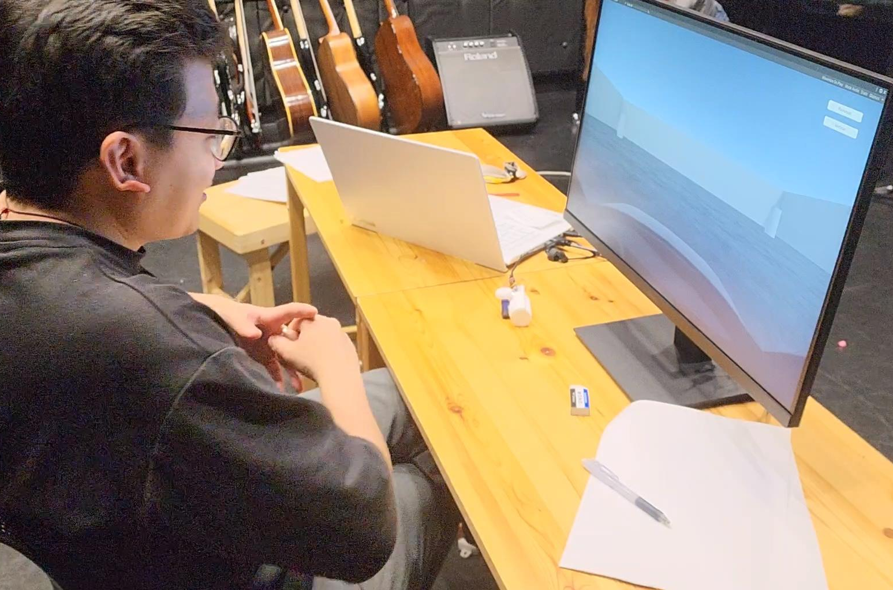
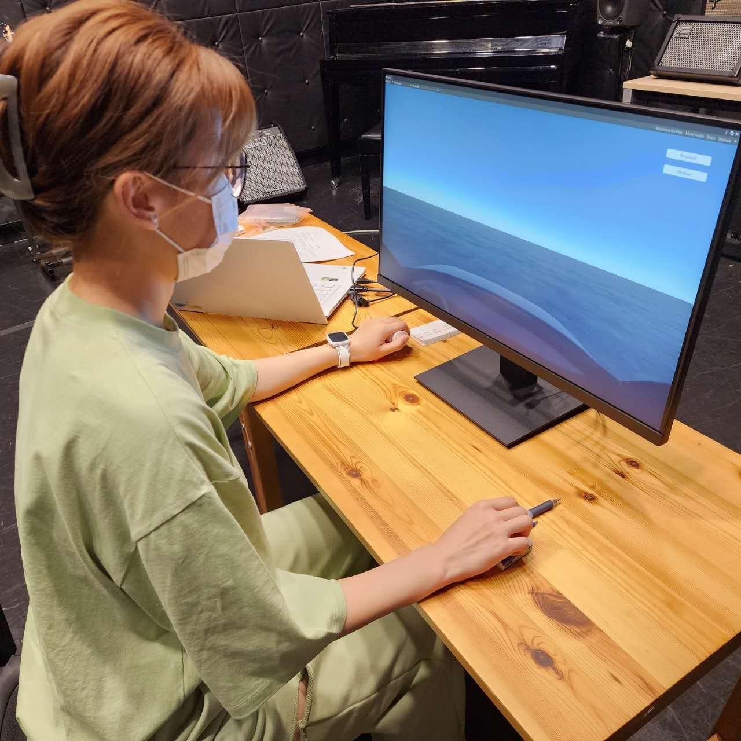
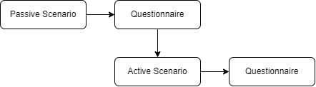
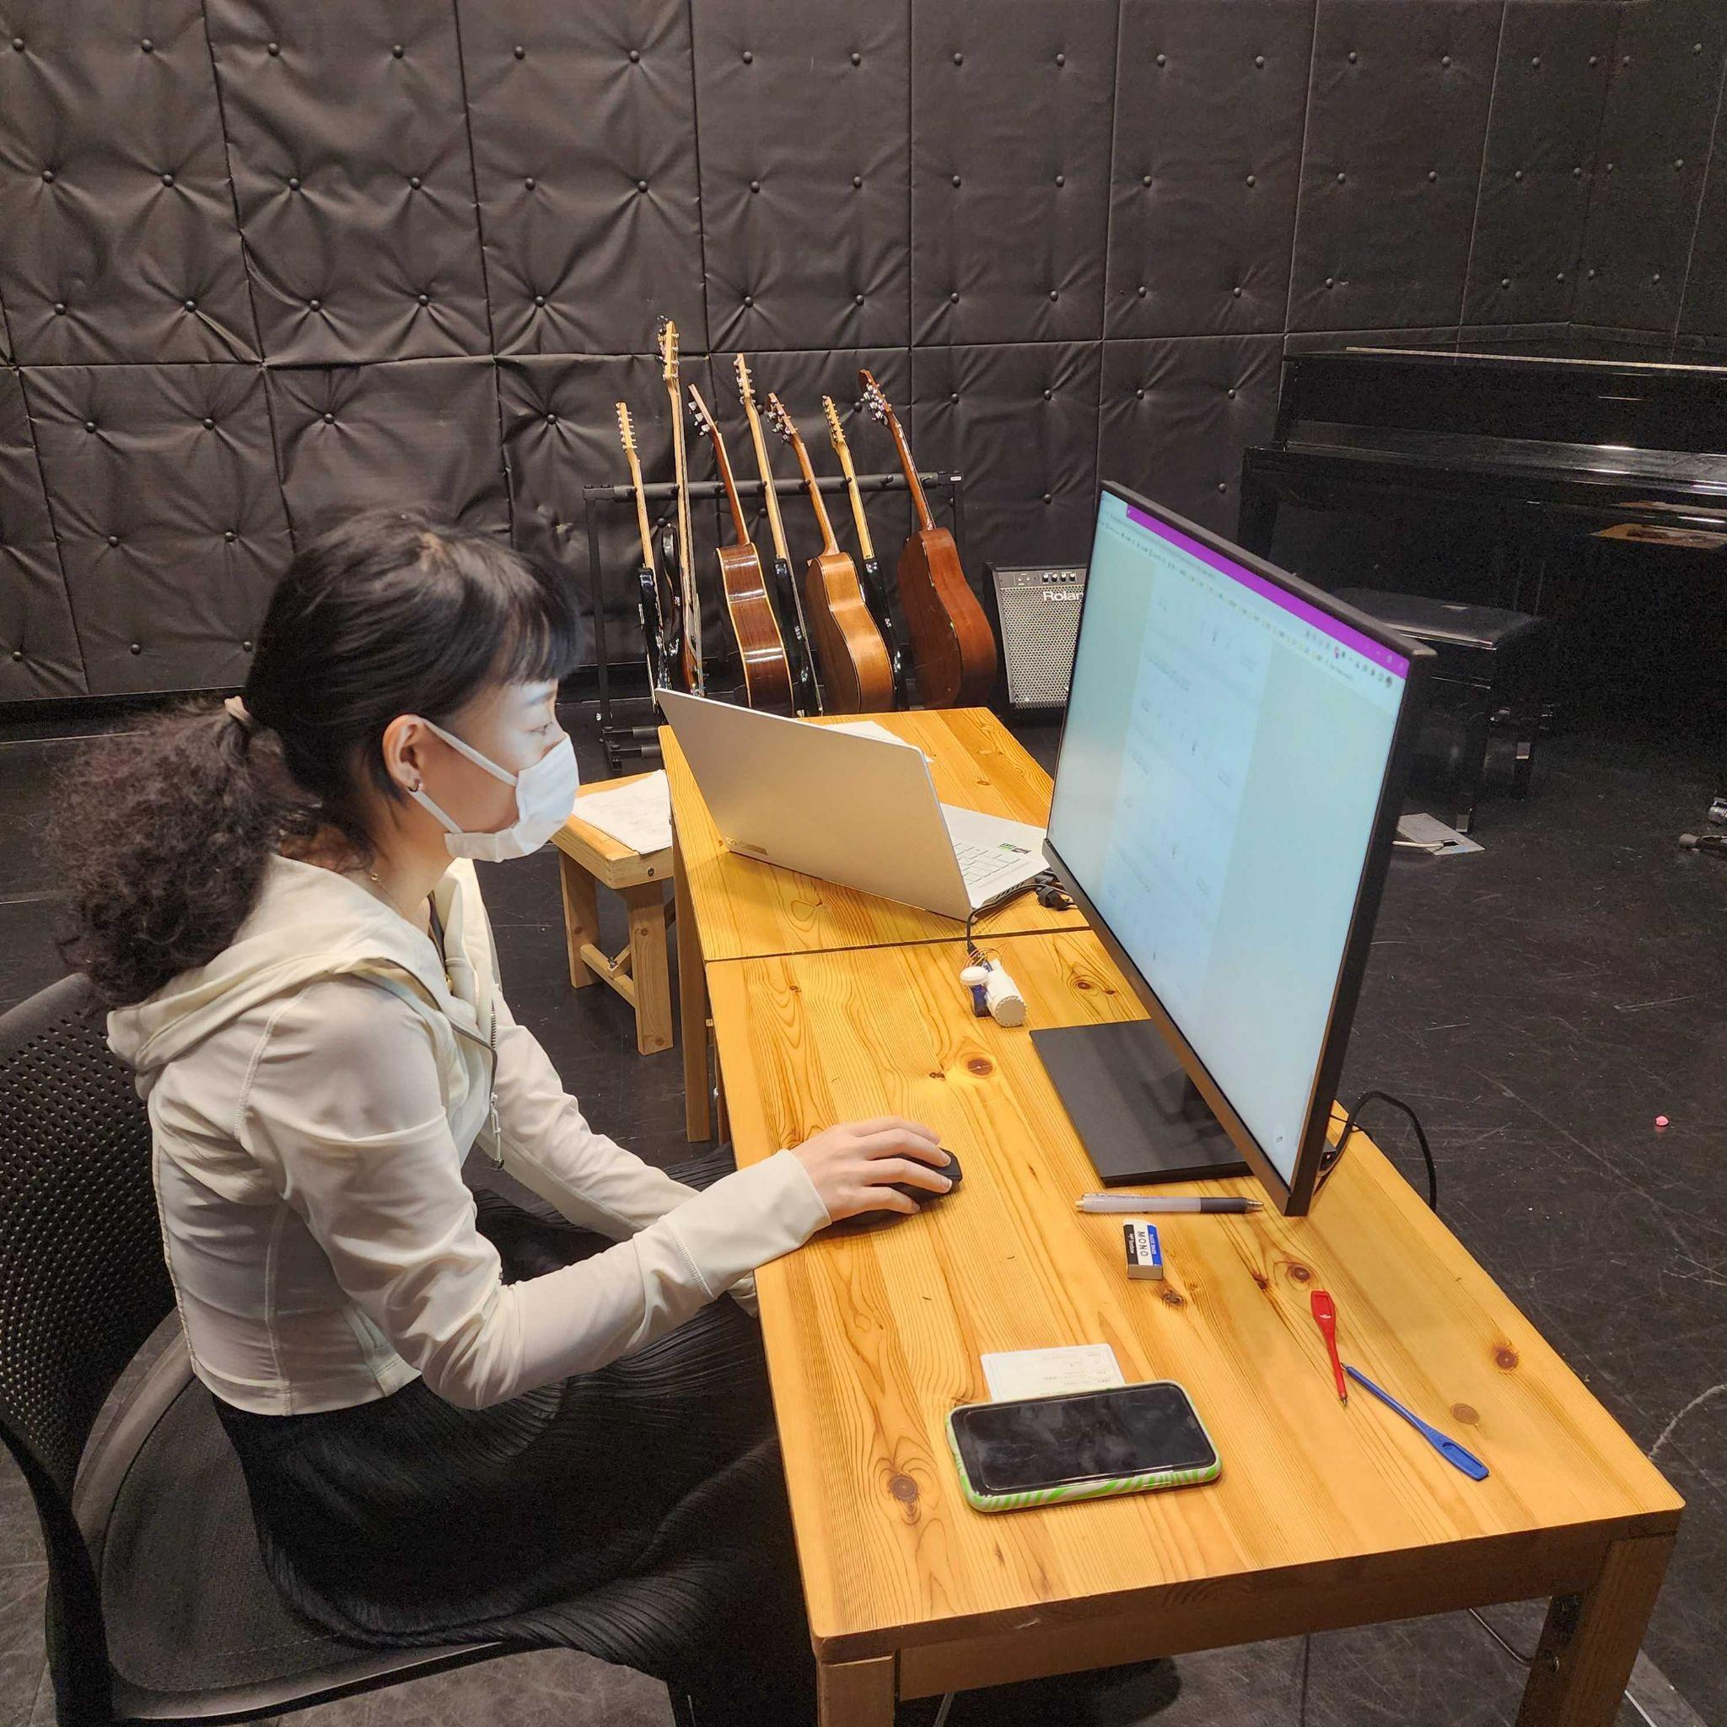
Proof of Concept
EXPERIMENTS
Experiment 2
User Experience (N=10)
Notes:
Two experiments were designed to test the haptic performance of and the user experience

Slide 23
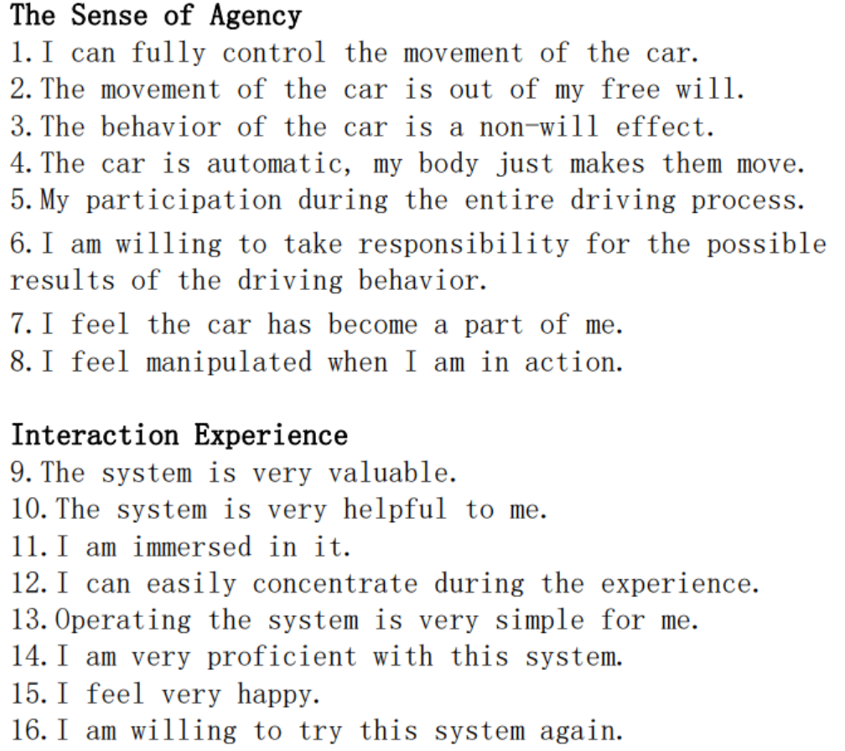
Proof of Concept
EXPERIMENT
2
User Experience (Passive)
Users do the experience within/without the MotionAvatar when the motion of the virtual vehicle is not operated by the user.
Then fill out the questionnaires.
User Experience (Active)
Users do the experience within/without the MotionAvatar when the motion of the virtual vehicle is actively operated by the user.
Then fill out the questionnaires.

Slide 24
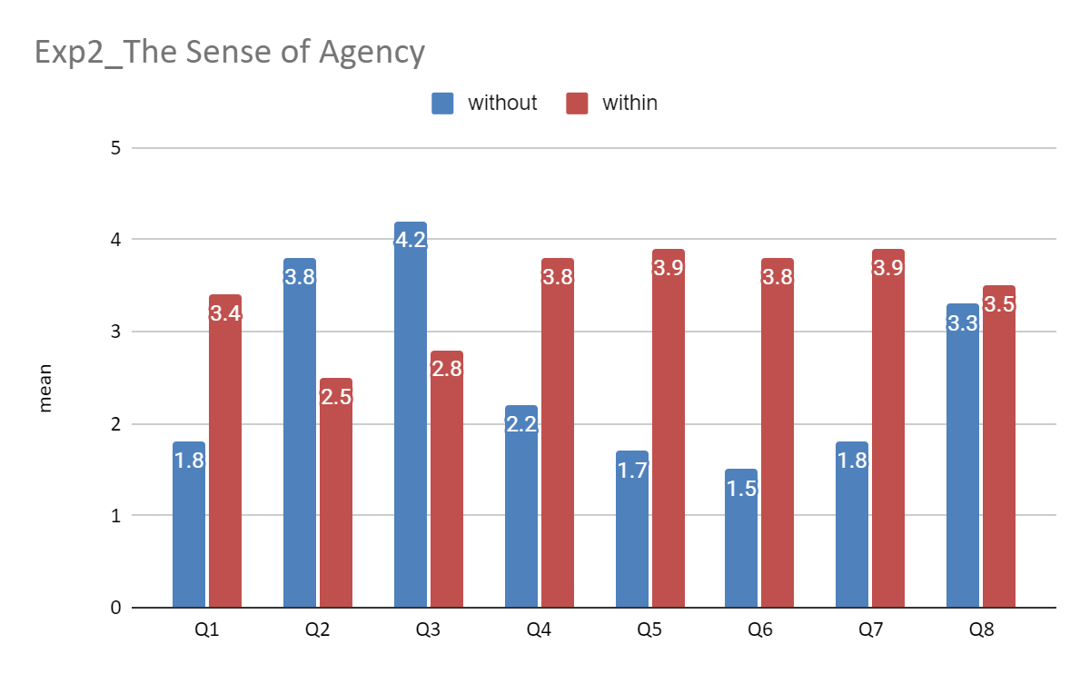
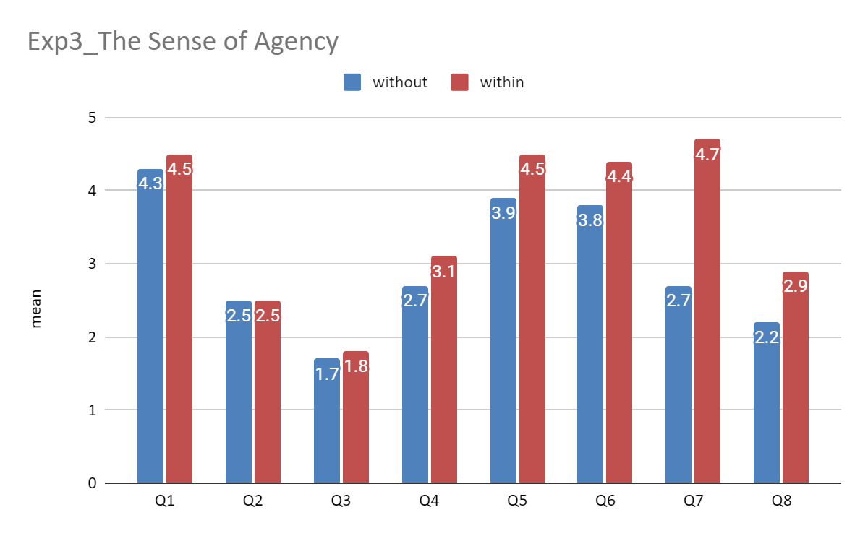
Discussion
RESULTS
User Experience_ The Sense of Agency
P | <.01 | <.01 | <.01 | <.05 | <.01 | <.001 | <.001 | ≧0.1
≧0.1 | ≧0.1 | ≧0.1 | ≧0.1 | ≧0.1 | ≧0.1 | <.001 | ≧0.1
2
1
3
Cohen's d | -1.5255 | 0.9676 | 1.4289 | -1.3242 | -1.7127 | -2.1880 | -1.9799
 |  |  |  |  |  | -2.5607

Slide 25
Discussion
FINDING
MotionAvatar enhances the user's trust in the AI driving system and the sense of involvement in the AI driving proceeding(Q6,Q5).
MotionAvatar allows users to create the illusion of active driving when they are not controlling the vehicle(Q1,Q3,Q4).
MotionAvatar can enhance the perception of identity in both passive and active driving situations(Q7).

Slide 26
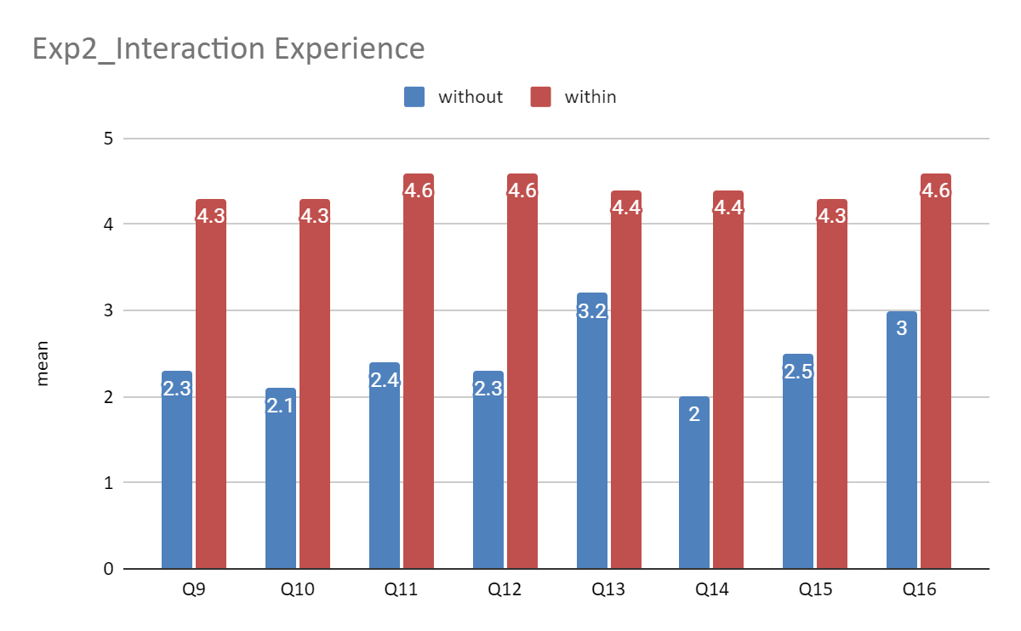
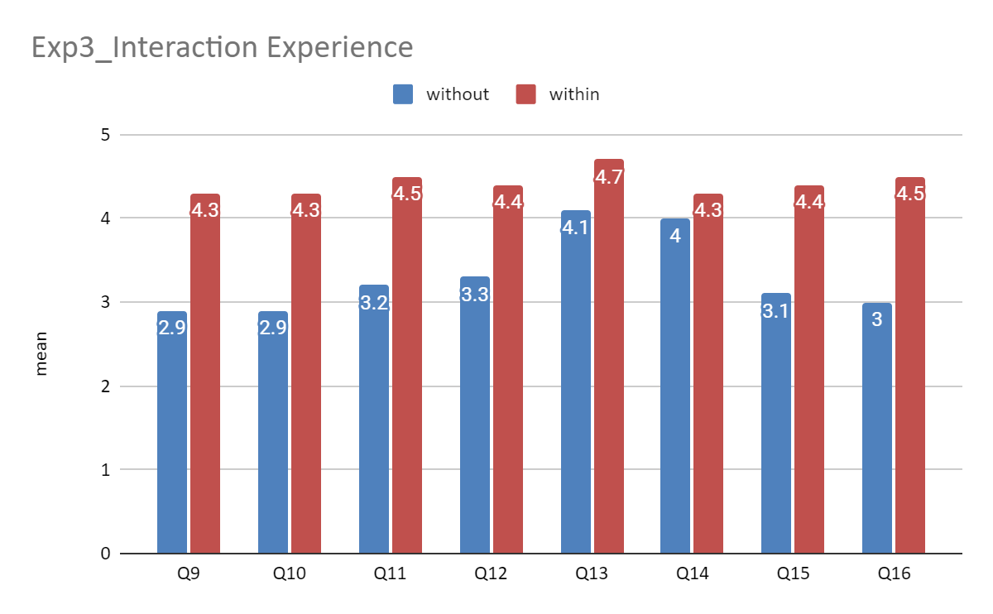
Discussion
RESULTS
User Experience_ Interaction Experience
3
4
4
P= | <.001 | <.001 | <.001 | <.01 | <0.1 | <.001 | <.001 | <.01
<.01 | <.01 | <.01 | <.05 | <.05 | <0.1 | <.01 | <.01
2
1
Cohen's d | -2.3736 | -1.8935 | -2.4004 | -2.2718 | -0.9798 | -2.8284 | -2.1067 | -1.6681
-1.4364 | -1.5185 | -1.5483 | -1.1437 | -0.6508 | -0.3154 | -1.3978 | -2.1213

Slide 27
Discussion
FINDING
MotionAvatar can enhance the immersion and realism during virtual driving(Q11).
MotionAvatar can enhance user focus while driving(Q12).
MotionAvatar enhances the user's understanding of driving behavior and operation(Q13,Q14).
MotionAvatar enhances the emotional value and fun of driving(Q15,Q16).

Slide 28
QUESTION
ANSWER
Can the motion state haptic feedback make users feel the vehicle’s motion ?
Whether it can improve the sense of connection between the user and the system ?
Whether it can improve the user's overall experience ?
MotionAvatar's scrolling design can effectively convey motion status information, especially motion direction.
MotionAvatar can enhance the user's sense of active driving agency in AI driving system.
MotionAvatar can enhance the user's experience and immersion in active driving scenario.
Notes:
Based on the above, we came up with these questions, which is also this research dedicated to solve

Slide 29
Discussion
FUTURE
Use better servers to enhance the reliability of equipment and explore how to establish a common haptic motion reference system.
To explore the performance and impact of MotionAvatar under the VR environment.
To explore whether can be applied to complex movements of the human body, such as running and swinging movements.

Slide 30
MotionAvatar:
An Ungrounded Haptic Device to Show the Self-motion of the Vehicle in Virtual Space
Closing
Thank you
EMBODIED MEDIA
ZHOU LU - 82136825

Slide 31
APPENDIX
FEEDBACK
Exp1
003
"My hand got a bit pinched."
004
"Everything felt faster and farther when haptic was involved, especially in the mixed condition while the visual didn’t feel that fast/far, the haptic felt very fast and far. And Significant system latency and noticeable jolting will greatly diminish the sense of immersion."
005
"After using the device, the physical reference became easier to grasp, and the experience became more intense."
001
"I think having haptic feedback in games or while driving would be quite magical. However, the feeling of moving forward and backward is more intense than turning."
002
"Haptic can provide me the intensity of movement which is something that only-visual cannot provide. But only-haptic cannot precisely provide me the information of the distance moved. So, the combination of haptic and visual can provide the best experience."

Slide 32
APPENDIX
FEEDBACK
Exp1
006
"Haptic touch gave me a stronger feeling when the car moves than visual."
007
"Visual haptic is much better for the experience. The haptic device is good for sensing speed."
008
”The feeling from haptic is strong, I can easily tell direction and angle, but not so much for speed changing. Haptic on palm is good, can keep fingers free for other things. When seeing and feeling at same time, I look at vision first but haptic feels faster.”
009
“Speed of vision and haptic not same, in experiment design, setting reference for haptic and vision speed first can help a lot in understanding later experiments.”
010
"When using only visual, it's difficult to perceive the angle. Only-haptic needs time to respond to left and right judgements."

Slide 33
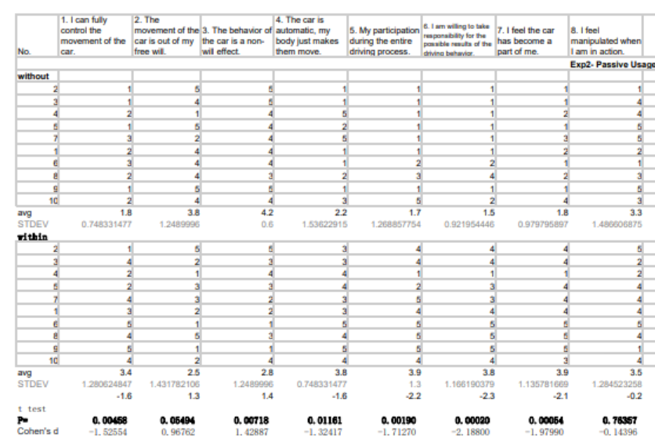
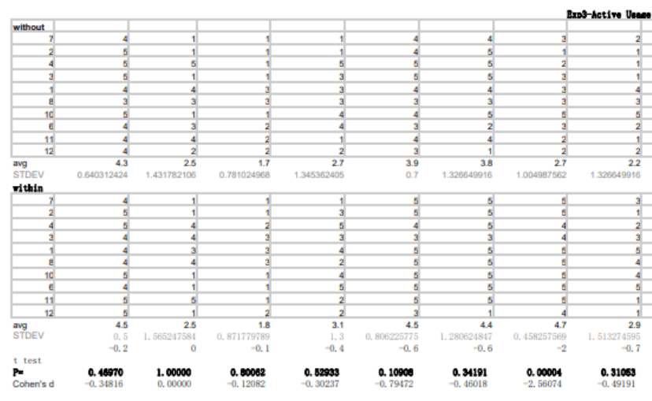
APPENDIX
DATASOURCE
The Sense of Agency

Slide 34


APPENDIX
DATASOURCE
Interaction Experience

